Slide 1
National CyberShield Hackathon 2025

Slide 2
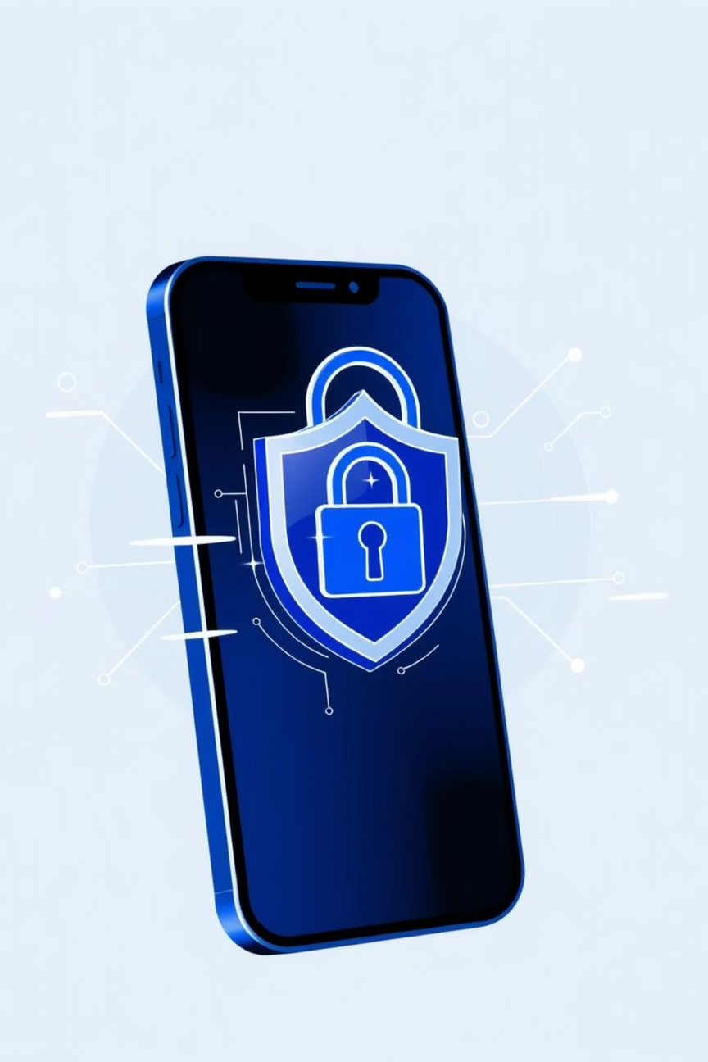
BankShield AI
From Fake Banking Apps to Catching Criminals
CIIS Hackathon 2025 Submission
Problem Statement : Detecting Fake Banking APKs (integrated with suspicious transactions & laundering detection)
Team: Cyber Monks
College: Institute of Technology And Management Gwalior

Slide 3
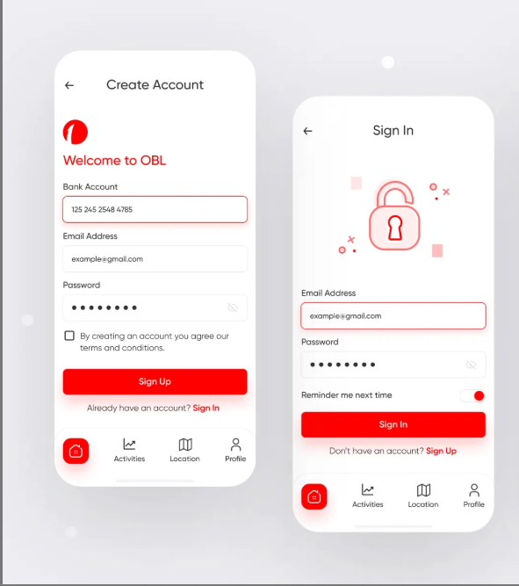
Idea
The Problem: An Invisible Threat
Fake banking APKs mimic legitimate applications, tricking users into revealing sensitive information like OTPs and UPI PINs. This stolen data is then used to initiate fraudulent transactions, with the funds rapidly laundered through complex networks.
Real vs Fake
Currently, victims and law enforcement only detect these incidents after the financial damage has occurred.
Our Idea:
Intercept threats at two critical layers – the device (APK) and
transactions (AI anomaly detection) – to proactively link them back to the criminal networks responsible. And not just detect the threat but also helps in catching the culprit

Slide 4




Technical Approach
BankShield AI leverages a robust technology stack to deliver accurate and efficient threat detection and attribution.
Backend & ML Core
APK Analysis
Python (FastAPI): For robust API services.ML Models (XGBoost/LightGBM): For high-performance classification.
Androguard, APKID: Static analysis of APKs.Frida Sandbox: Dynamic analysis for runtime behavior.
Transaction Intelligence
Data & UI
AI Anomaly Models: Identify unusual transaction patterns.Rule Engine: Customisable rules for specific alerts.
Graph DB: For complex laundering pattern detection.React + Postgres: Intuitive dashboard for cyber departments.

Slide 5

Methodology and process for implementation
BankShield AI: A Multi-Layered Defense
Our solution provides an end-to-end defense system, from detecting fake applications to tracing stolen funds and attributing criminal actors. It operates through four integrated layers, ensuring comprehensive protection.
APK Analyzer
Suspicious Transaction Engine
Laundering Detector
Attribution Layer

Slide 6
Feasibility And Viability
Addressing Data Challenges:
Strategic Roadmap:
Sensitive banking data requires careful handling. We overcome this with synthetic data generation and federated learning approaches, ensuring privacy and compliance.
Hackathon POC
Proof of Concept with core functionalities.
Cyber Cell Pilot
Deployment Strategy:
Real-world testing with law enforcement agencies.
Citizen Mobile App: A lite version for personal APK scanning.
National Scale Deployment
Cyber Department Dashboard: Comprehensive platform for investigation and evidence generation.
Widespread adoption across banking and cyber security.

Slide 7




Impact and Benefits
BankShield AI delivers tangible benefits across key stakeholders:
For Citizens
Enhanced Safety: Proactive self-scanning for fake apps, preventing fraud before it happens.
For Banks
Reduced Fraud Loss: Significant decrease in financial fraud cases and associated operational costs.
For Cyber Police
Complete Evidence Chain: End-to-end traceability from malicious APK to mule accounts and the ultimate criminals.

Slide 8





Research and References
Our solution is built upon extensive research and insights from leading authorities in cybersecurity and financial crime.
RBI Advisory (2019, 2021): Warnings on fake banking apps and phishing campaigns.
CERT-In Guidelines (2020–23): Alerts on Android malware & phishing domains.
MITRE ATT&CK Framework: Understanding mobile-specific tactics and techniques used by adversaries.
AML Pattern Detection Papers: Incorporating advanced methodologies for anti-money laundering.
AndroGuard/ Apkid: open-source apk reverse engineering.
AI-Based Fraud Detection in Financial Transactions: Springer.
“No sensitive or restricted cybercrime data was used. All references are open-source / public domain.”

Slide 9
Team Member Details
Reg.No/ Enrol.No | Name | Year/ Semester | Name of College/ Department | City/ State | Male/ Female | Mail Id | Mobile No
1. 0905AL231019 | Ayush Agrawal | 3rd/5th | Institute of technology & management Gwalior | Gwalior/Madhya Pradesh | Male | 200ayush200@gmail.com | 9522531502
2. 0905AL231026 | Divyam Agrawal | 3rd/5th | Institute of technology & management Gwalior | Gwalior/Madhya Pradesh | Male | divyamagrawal05@gmail.com | 8817040672
3. 0905AL231036 | Harshit Jain | 3rd/5th | Institute of technology & management Gwalior | Gwalior/Madhya Pradesh | Male | harshitjainp887@gmail.com | 8871670959
4. 0905AL231027 | Divyanshi Goyal | 3rd/5th | Institute of technology & management Gwalior | Morena/Madhya Pradesh | Female | d1vy4nshi2002@gmail.com | 9584403180
5. 0905CS231141 | Krishna Goyal | 3rd/5th | Institute of technology & management Gwalior | Morena/Madhya Pradesh | Male | n1nj4cod3@proton.me | 9584403162
Mentor Detail
Staff Id | Name | School/ Department | Mail Id | Phone . No
1. | Rohit Singh Thakur | Institute of Technology & management Gwalior | Rohitsinghthakur.cse@itmgoi.in | 9926470763

Slide 10


The Victim's Journey: Before & After BankShield AI
Scenario: The Bait
The Attack: Money Gone
BankShield AI: Intercepted!
Imagine you download SBI_Secure.apk from WhatsApp… next morning ₹50,000 gone. This is where BankShield AI steps in
Upon launching, the fake app captures OTPs and UPI PINs. ₹50,000 is swiftly drained from the user's account.
BankShield AI detects the fake APK, flags the suspicious transaction, and automatically traces the mule account, triggering an alert.
BankShield AI transforms reactive investigation into proactive intervention, protecting citizens and providing crucial evidence for attribution.

Slide 11
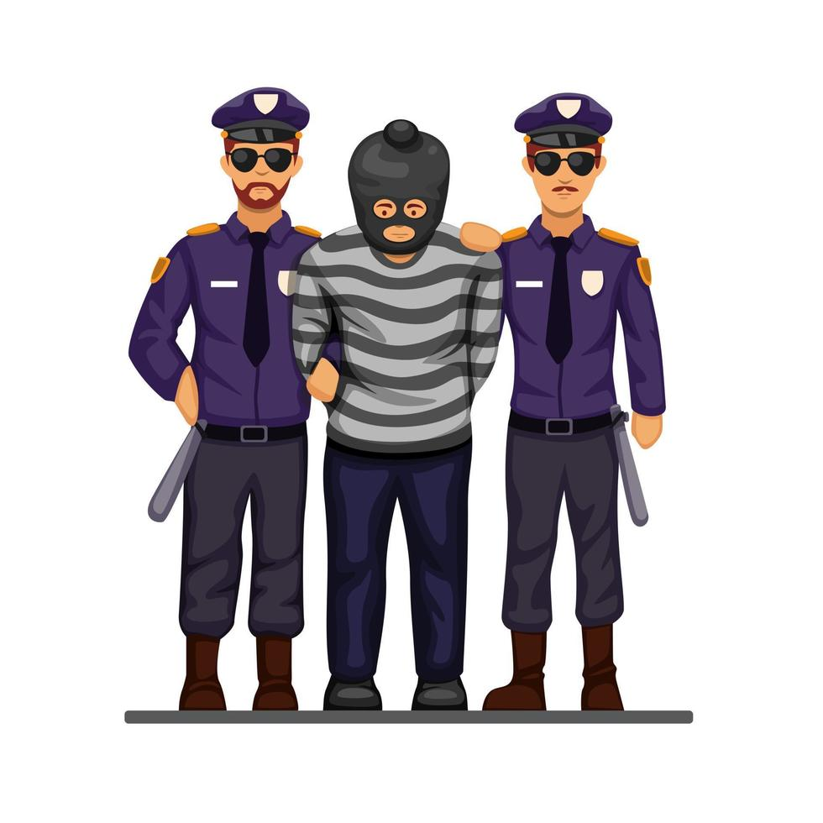
BankShield AI: The 4-Layer Architecture
BankShield AI employs a sophisticated multi-layered defense system to protect users and combat financial cybercrime.
Device (APK) Analysis
Transaction Anomaly AI
Identifies malicious applications on the user's device.
Or can be identified by uploading it to a dashboard
Detects suspicious and fraudulent transaction patterns in real-time.
Laundering Graph
Attribution Layer
Traces the flow of illicit funds through complex networks
and file the mule accounts.
Pinpoints criminal actors and their networks for law enforcement. Which helps the police department
to catch the culprit.

Slide 12
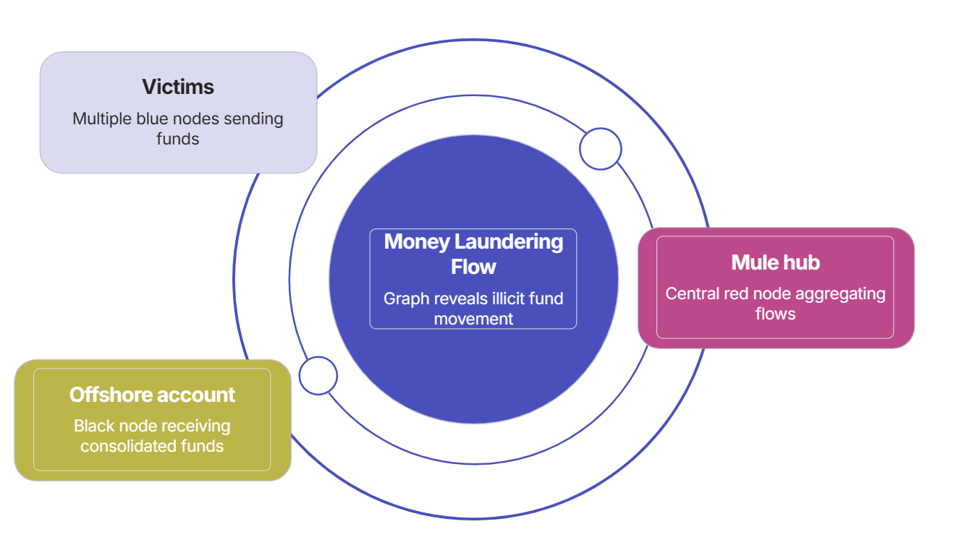
Transaction Graph Example
(For tracking Suspicious transactions and Money laundering system)
Victims account
(outer layer)
offshore accounts
(middle layer)
mule accounts
(center zone)

Slide 13
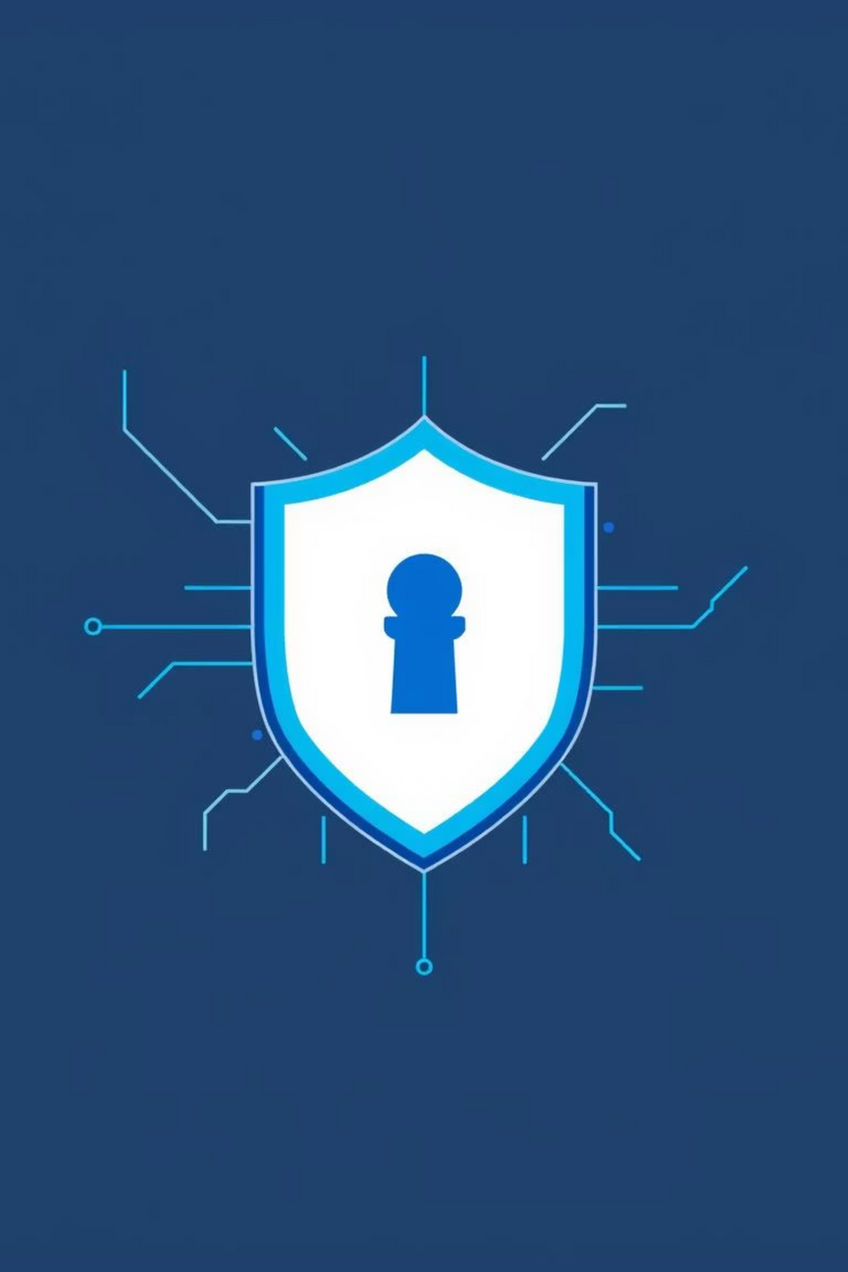
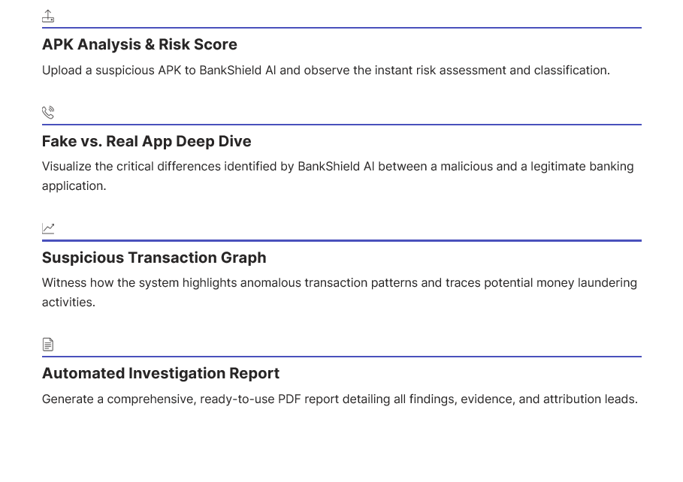
Demo Plan
Our demonstration will walk you through BankShield AI's capabilities, showcasing its power in real-time:

Slide 14
Future Scope: Launching Forward
BankShield AI is continuously evolving to address emerging threats and expand its protective capabilities.
Citizen App
National Whitelist
Proactive self-scanning for fake banking applications, empowering users directly.
Establishing a trusted registry of legitimate banking apps across the nation.
Wider Integration
Advanced AI Defenses
Seamless data and intelligence sharing with RBI, CERT-IN, and telecom providers.
Leveraging AI to detect deepfake overlays and sophisticated phishing attempts.

Slide 15

Closing: Why BankShield AI?
"Not just detection, but prevention + attribution."
Protecting Citizens, Empowering Cyber Police.

